Slide 1
How To Chair A Meeting
The Single Highest Service Commitment In Narcotics Anonymous
(Aside from being the Coffee Maker, that’s some important stuff, too)

Slide 2
APATHY

Slide 3
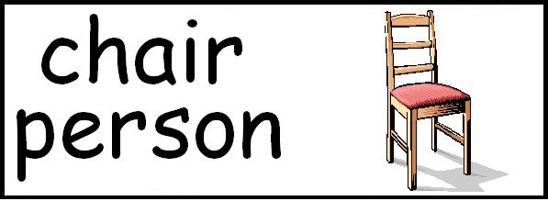
What Is A Chairperson
A chairperson of a Narcotics Anonymous recovery meeting is an addict who is primarily responsible for maintaining an “atmosphere of recovery” during the meeting.

Slide 4
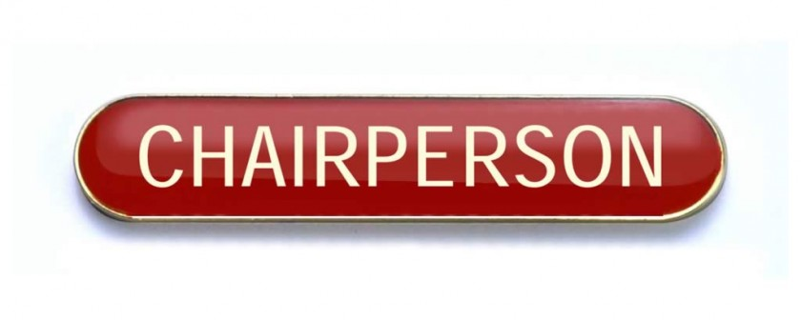
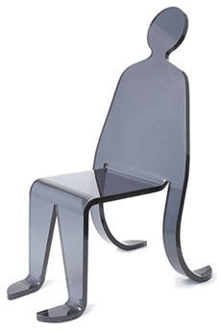
WHAT?
There is a marked difference between being primarily responsible and being solely responsible. As members of NA, each of us is responsible. Not only for our own conduct at a meeting, but to help educate the less experienced members on how our meetings operate and what each member should do to help further our primary purpose. To make one person solely responsible for that task would set him/her apart from the group by making him/her an ultimate authority figure (see Traditions 2 & 12.).

Slide 5
Guiding Principles Traditions and Concepts:
Tradition 2. For our group purpose there is but one ultimate authority— a loving God as He may express Himself in our group conscience. Our leaders are but trusted servants; they do not govern.
Tradition 12. Anonymity is the spiritual foundation of all our Traditions, ever reminding us to place principles before personalities.
Concept 4. Effective leadership is highly valued in Narcotics Anonymous. Leadership qualities should be carefully considered when selecting trusted servants.
Concept 5. For each responsibility assigned to the service structure, a single point of decision and accountability should be clearly defined.

Slide 6
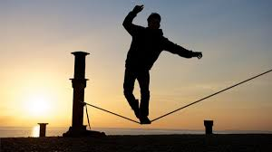
WHY DO WE NEED CHAIRPEOPLE?
We give the chairperson the primary responsibility to maintain order in a meeting so the NA message of recovery can be heard without obstruction. If any of us could talk whenever, as often, and as long as we wanted, only those members with the strongest personalities would ever get a chance to share.
It is also important that we follow an established format (usually decided upon at the group’s business meeting). Before chairing a meeting you should know where the format may be found. By using a meeting format, our experience shows that we can achieve much more sharing in much less time.

Slide 7
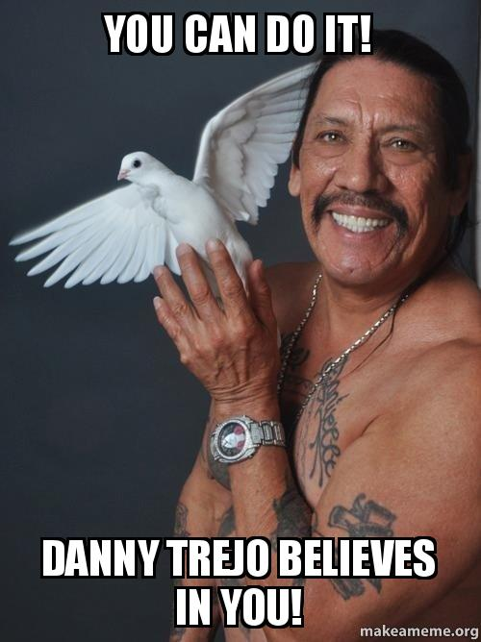
WHO CAN BE A CHAIRPERSON?
Any member of NA with a desire to serve and that meets any requirements established by their group. The responsibilities of the chairperson are a serious matter. Suffering and recovering addicts are depending on you.

Slide 8
Requirements To Chair
A working knowledge of the 12 Traditions of NA.
An active NA step program (you’re working the steps.)
The willingness to be assertive, patient and tolerant.
The ability to express yourself in a loving manner.
The willingness to fulfill the commitments you made to open, chair and close the meeting.

Slide 9
BEFORE THE MEETING
Arrive at least 30 minutes before the meeting.
Clean up the meeting room if needed.
Help make coffee, set out cream, sugar, cups, stir sticks, etc. if needed.
Help set out literature and key tags if necessary.
Have announcements, readings and anything else you may need ready before the meeting starts.
Have a topic prepared if there isn’t one specified.

Slide 10
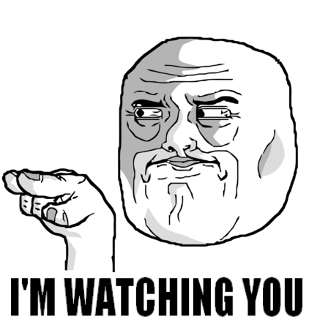
During The Meeting
Start and end the meeting on time.
Follow the suggested meeting format.
Maintain order and observance of the 12 Traditions.
Remember to observe the 7th Tradition (pass the basket).

Slide 11
AFTER THE MEETING
The chairperson is responsible for cleaning up. Ask for help, but please make sure the following things are done: • Help clean up the coffee pot and supplies.
Help take out the garbage if it is full.
Help record the 7th Tradition, and store the funds according to the practices of this group.
Make sure everything is picked up and clean. Wipe down the tables; turn off the coffee pot and lights.
Leave the meeting place as clean or cleaner than you found it.

Slide 12
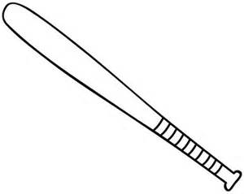
HOW SHOULD A DISRUPTION DURING THE MEETING BE HANDLED?
There are different types of disruptions, please see the service pamphlet “Disruptive and Violent Behavior”. One good rule of thumb is, if the disturbance is brief and not very noticeable by the entire group, ignore it!
If the problem is severe or persists, then you may have to address it. If you need to restore order to the meeting, one way would be to say “Excuse me. We are trying to have a meeting

Slide 13
Disruptions
A chair person may suspend the meeting for a five minutes recess, restarting with an opening prayer, or in the most severe disruptions, it may be best to adjourn the meeting early. Group members must be willing to do whatever is necessary to fulfil their primary purpose even under disruptive circumstances.

Slide 14
DISCUSSION: WHAT MAKES A GOOD MEETING?
If You Know The Difference, Be The Difference

Slide 15
Formats
Different Types of Meetings-Our Diversity Is Our Strength
Following The Groups Written Format/Having a Written Format
Clearly Explain The Format

Slide 16
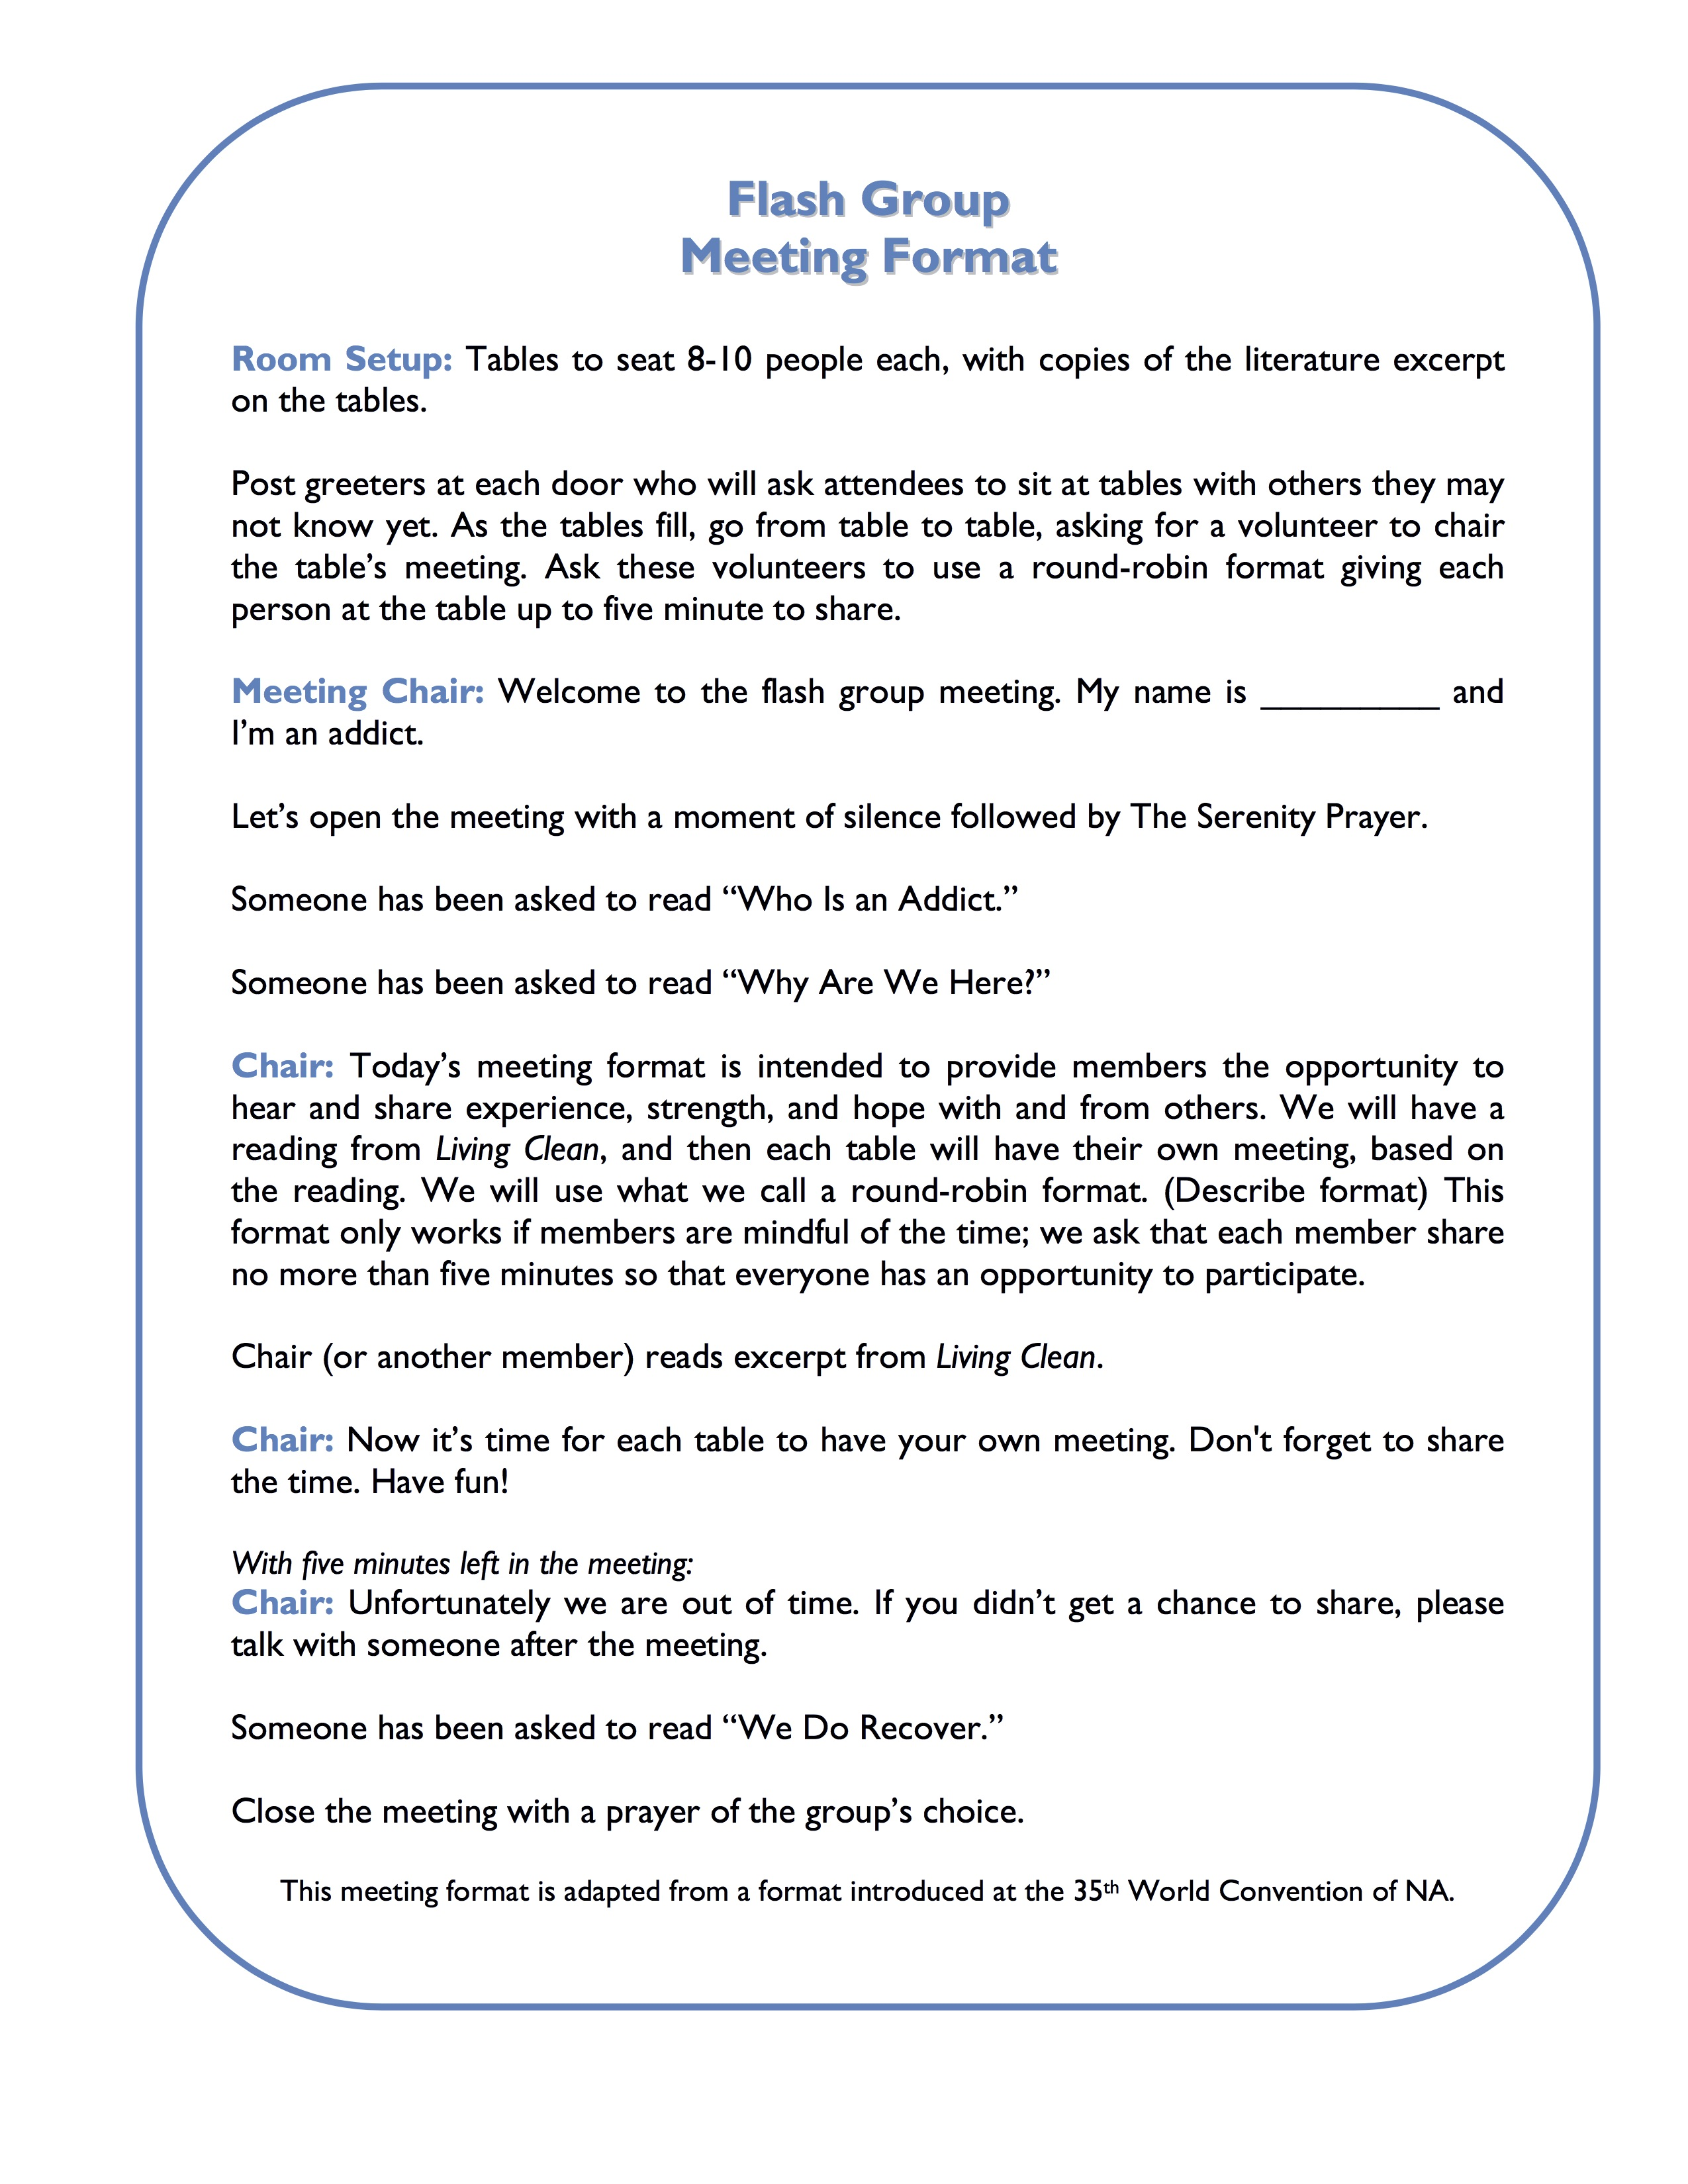
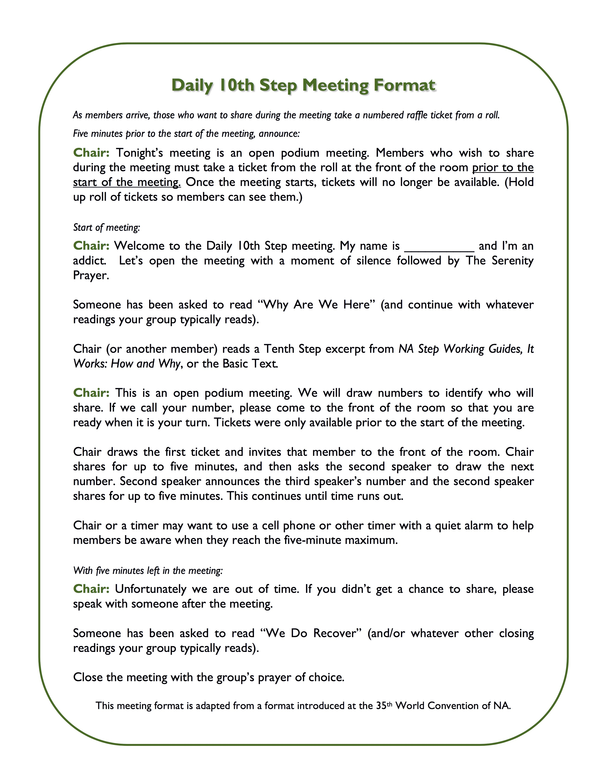
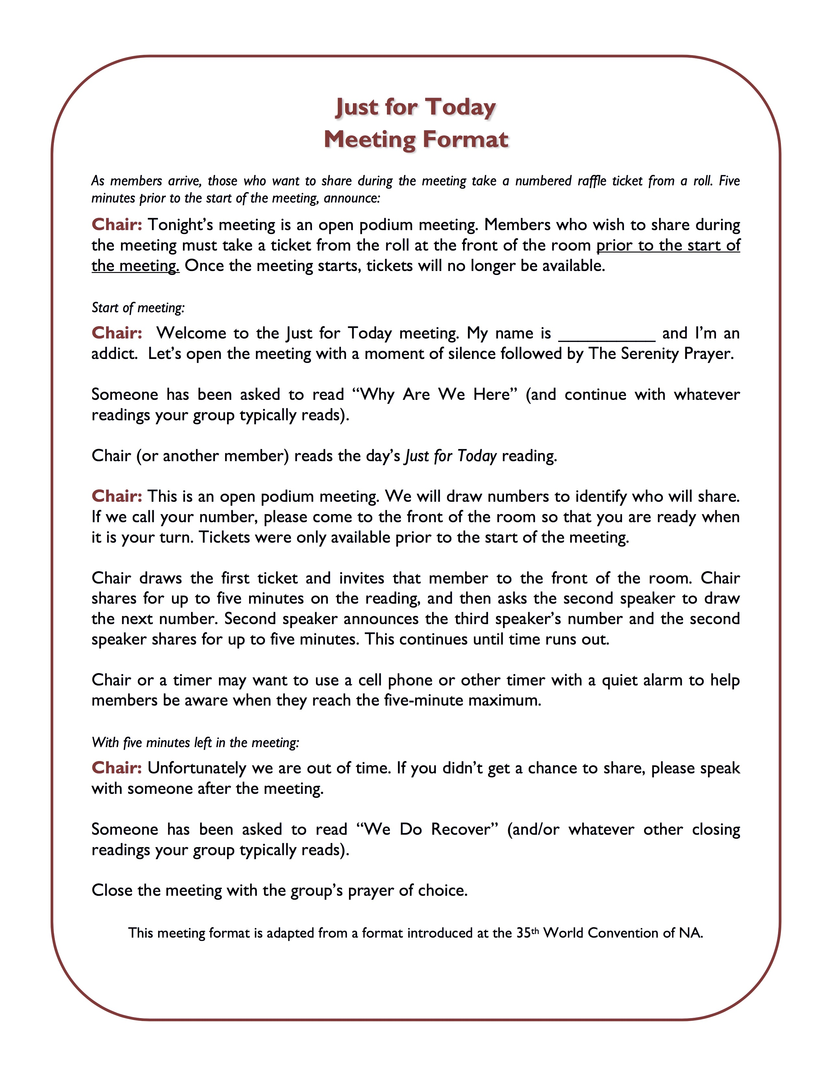
Examples

Slide 17
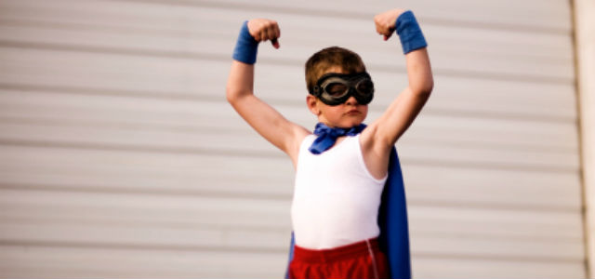
Ideas, Thoughts and Whimsical Offerings

